Slide 1
Ada Boost:
Ada Boost or Adaptive Boosting
It works same as normal Boosting algorithm.
Transforms weak learners to strong learners
Reassign weight to each instance, higher weight for incorrectly classified. This reduces bias and variance.
Used for both classification and regression problems.
Stump
Root node No fixed depth, AdaBoost takes only stumps
Leaf Node

Slide 2
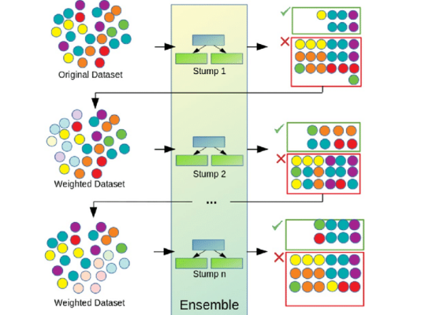
3 ideas behind Ada Boost:
Stumps can use only one variable to make a decision
so it is a Weak Learner.
3 ideas of Ada Boost:
1. Ada Boost combines lot of weak learners to make classification. Weak learners are always stumps.
2. Some stumps get more say in classification than
others.
3.Each stump is made by taking the previous stump’s
mistakes into account.
Misclassified data / Incorrectly Classified data

Slide 3
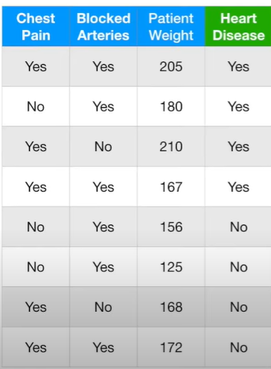
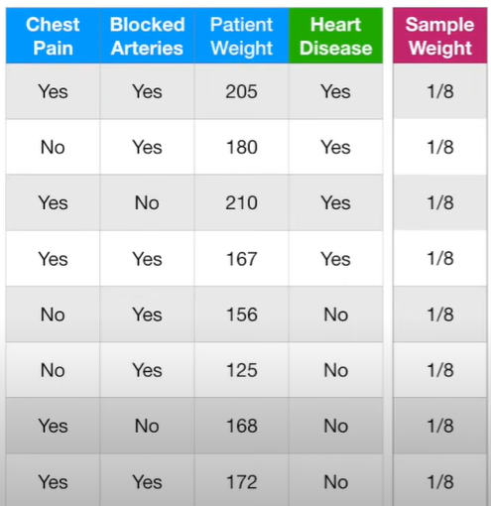
Example:
Here we have to predict Heart Disease (Output) and other 3 columns are Input.
First to predict the patient has heart disease or not , we give each sample a weight that indicates how important it is correctly classified.
At the start , all samples get same weight
Sample Weight = 1 = 1/8
Total no. of samples

Slide 4
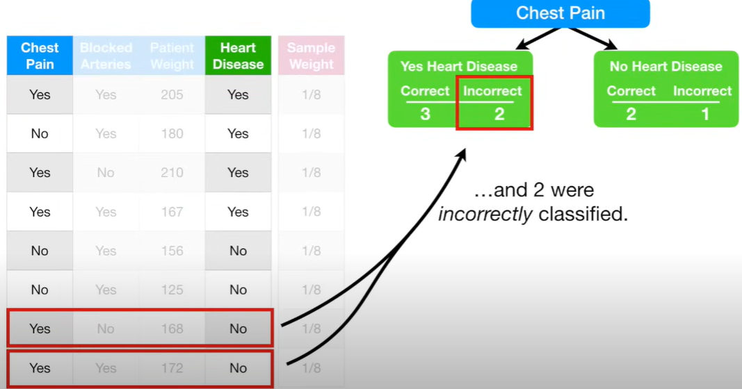
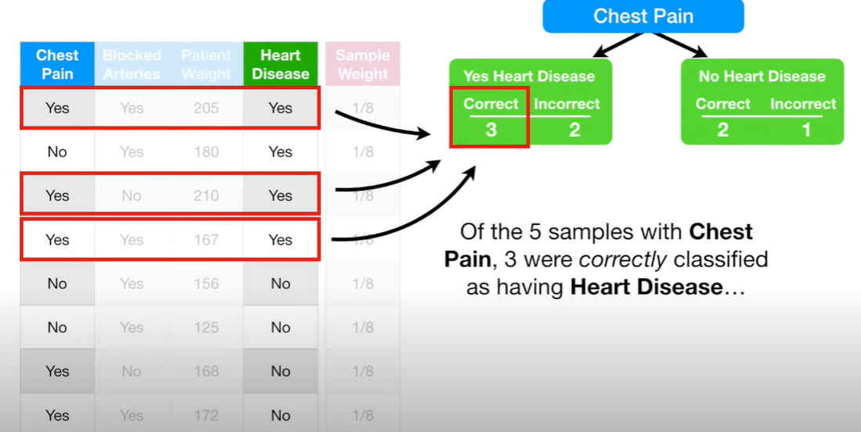
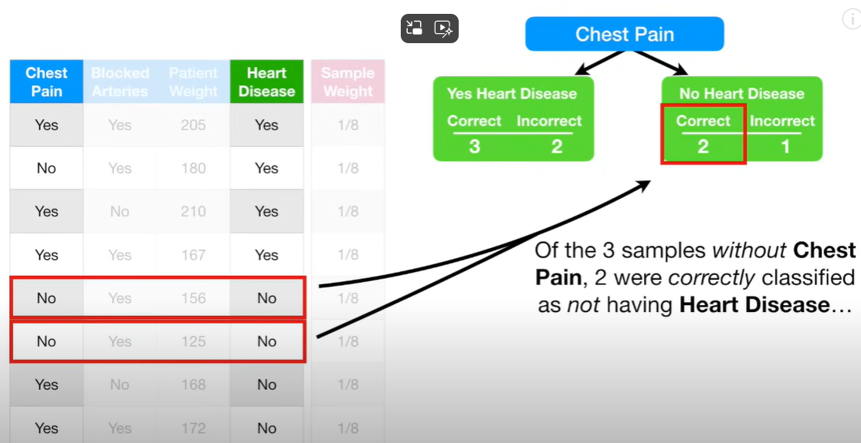
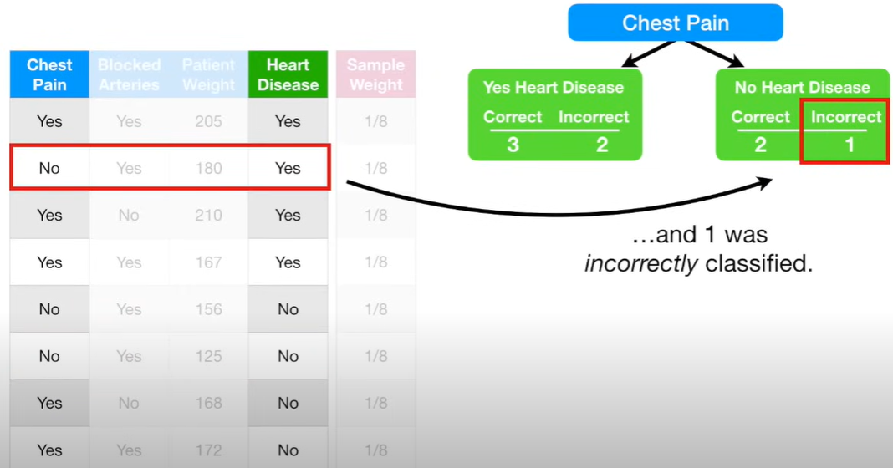
Chest Pain Classifies:

Slide 5
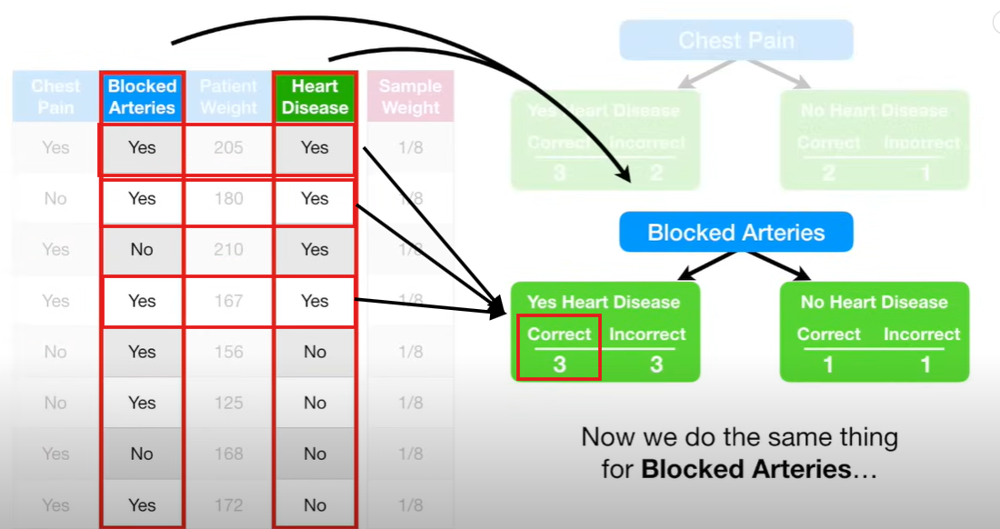
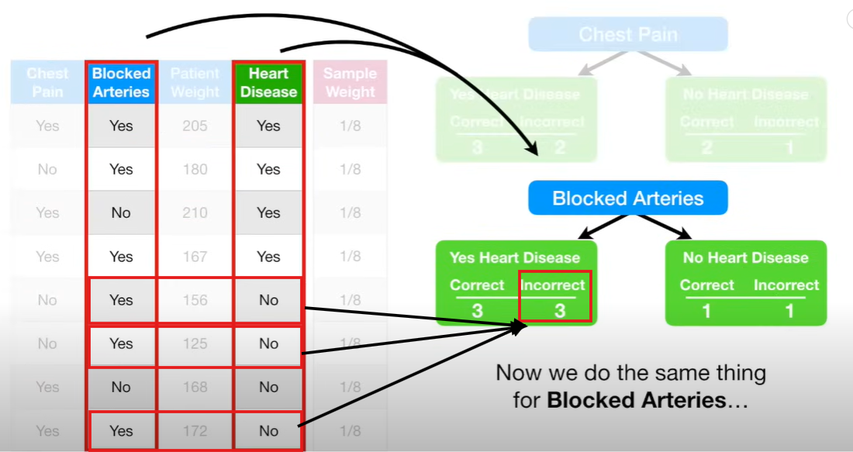
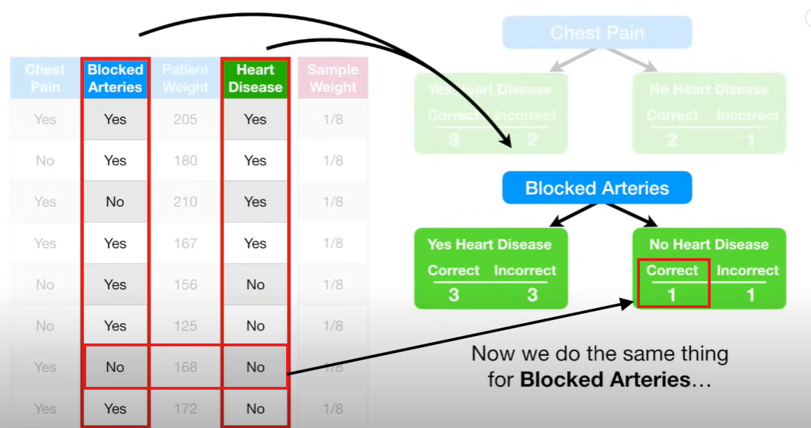
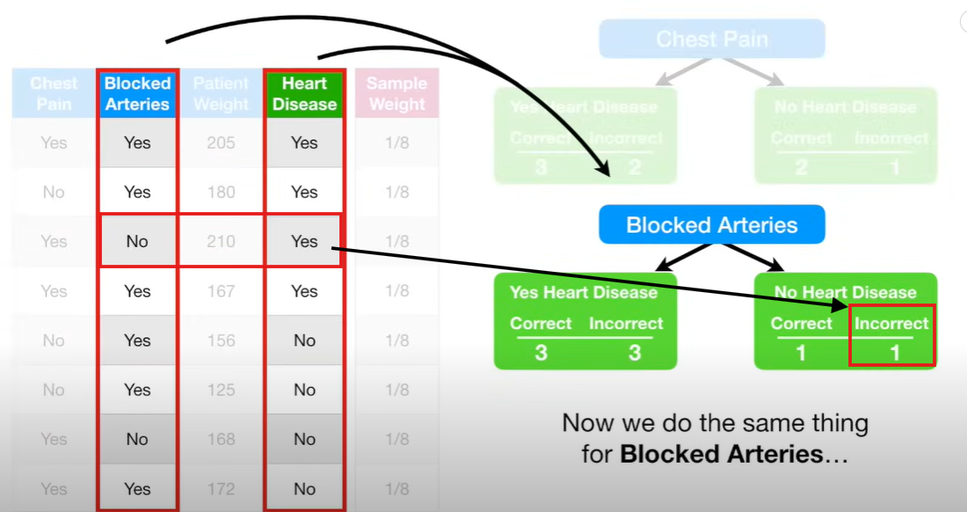
Blocked Arteries:

Slide 6
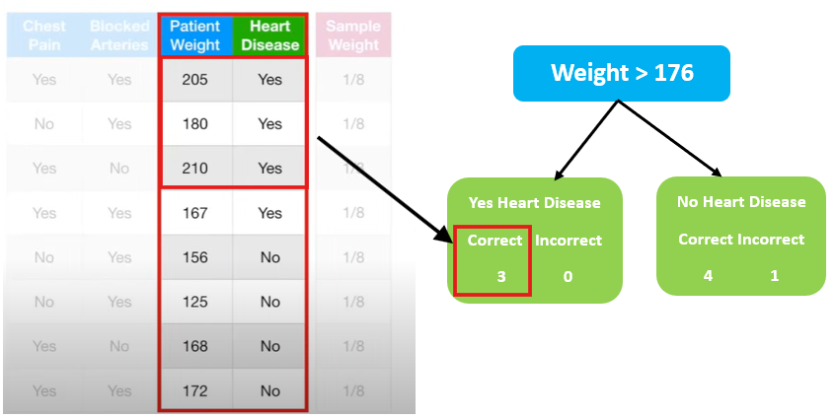
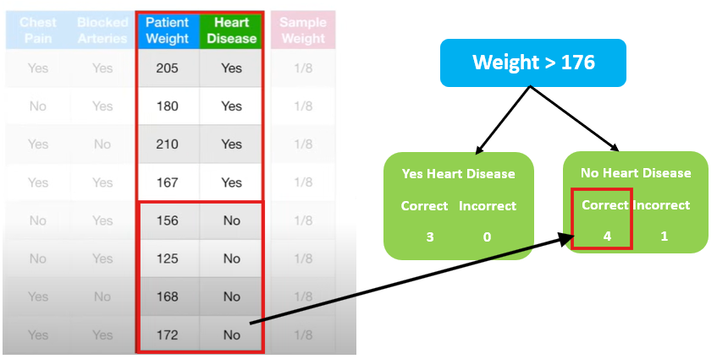
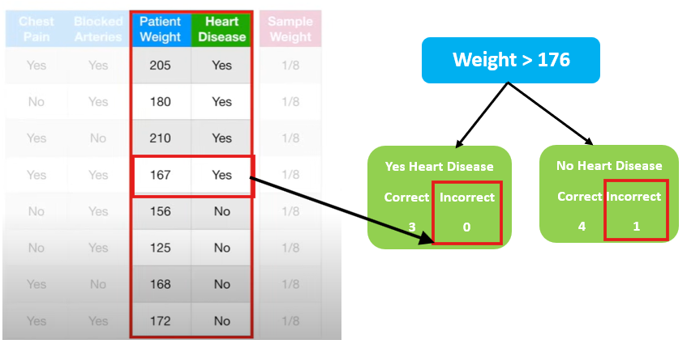
Patient Weight:
We used the techniques described in Decision tree StatQuest to determine that 176 was the best weight to separate the patients.
Here stump is created incorrectly, it should it 1 in Incorrect(Yes) and 0 in Incorrect(No)

Slide 7
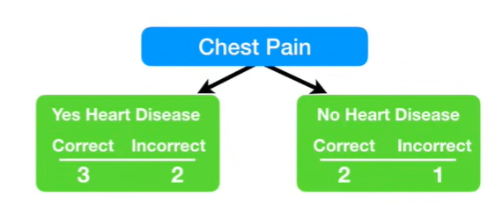
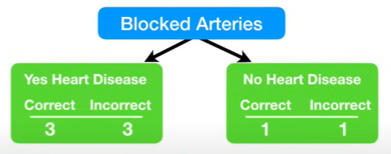
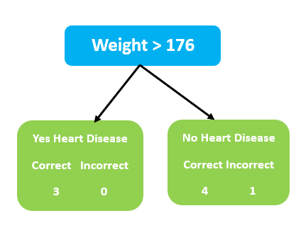
Gini Index 0.47
Gini Index 0.5
Gini Index 0.2
We calculate Gini index for all 3 stumps.
Gini Index for Patient Weight is the lowest
So this Patient Weight will be the first stump in the forest.

Slide 8
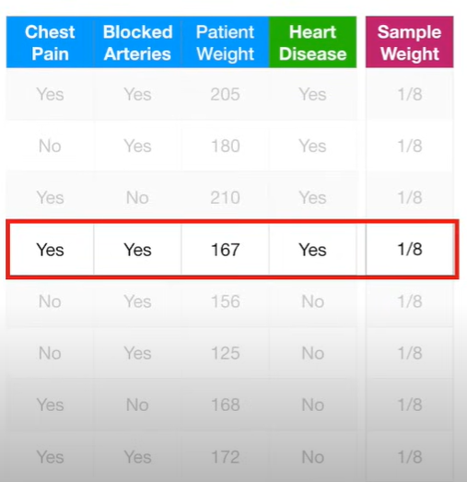
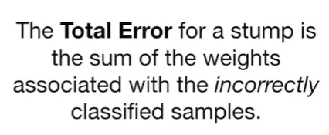
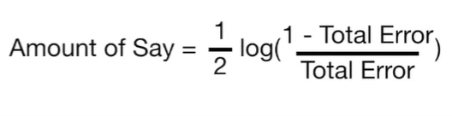
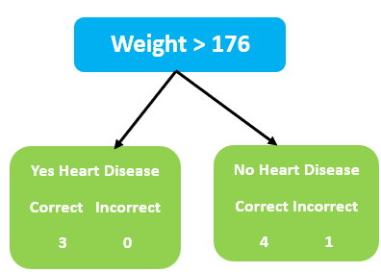
Total Error Calculation:
=1/2 log (1-1/8)
1/8
=1/2 log(7)
=0.97
Final Classification is 0.97

Slide 9
Let’s consider if Chest Pain would be the first stump then,
Total Error = 1/8 + 1/8 + 1/8 = 3/8
If Blocked Arteries would be first stump then,
Total Error = 1/8 + 1/8 + 1/8 + 1/8 = 4/8
= ½ log(1-3/8) = 0.42
3/8
= ½ log(1-4/8) = 0.2
4/8

Slide 10
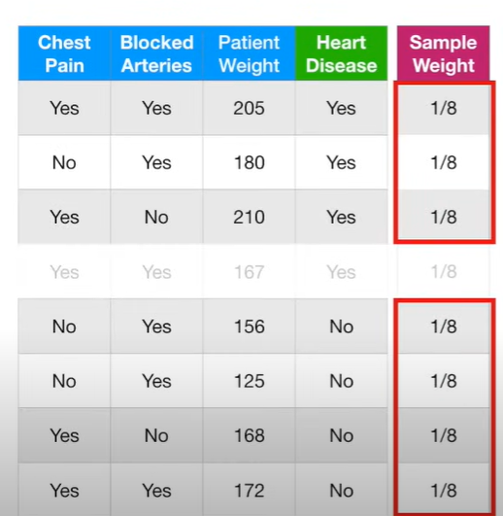
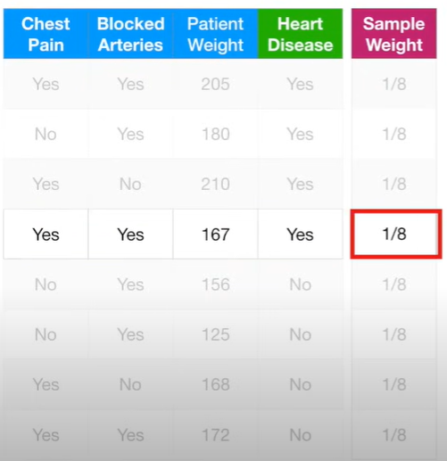
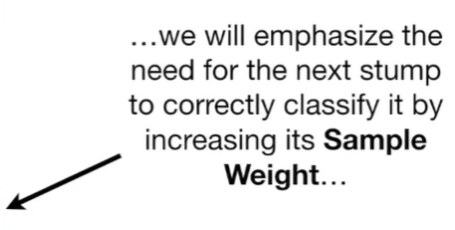
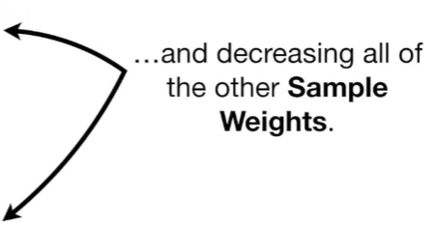
Initially all the sample weight has same weight.
After first stump we found below row as incorrect sample weight so we need to increase that sample weight and decrease other sample weight.

Slide 11
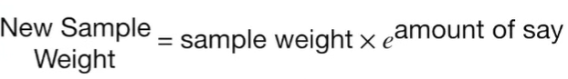
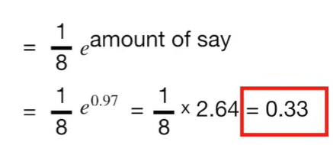
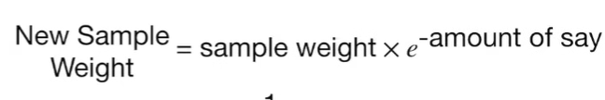
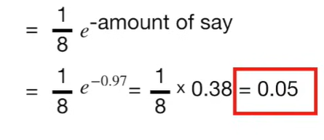
Formula to increase/decrease sample weight:
This is larger than the old one (i.e) 1/8=0.125
Increase sample weight
Decrease sample weight
This is smaller than the old one (i.e) 1/8=0.125

Slide 12
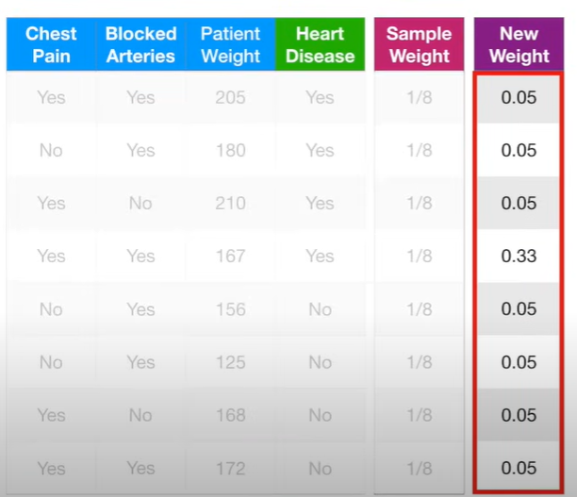
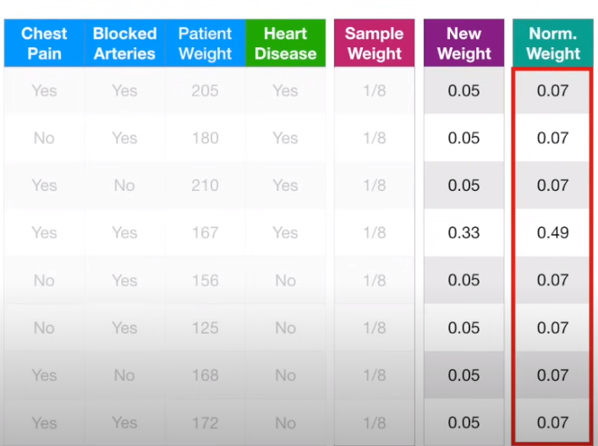
Adding New sample weight and Normalized weight:
If we add the new weight we get 0.68 and now we have to divide each new weight by 0.68 to get normalized weight

Slide 13
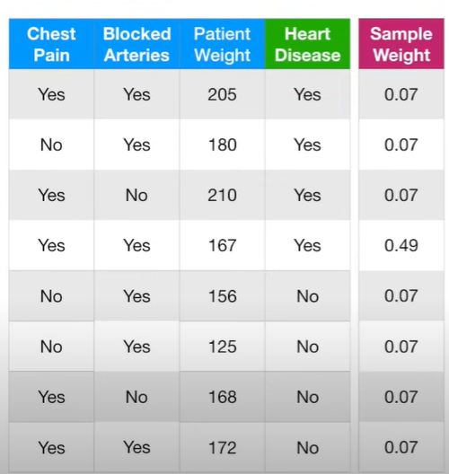
Create next stump by calculating Gini Index:
With this sample weight we calculate Gini Index to determine which variable should split the next stump.
If number is between 0 to 0.07 then we put this sample into new collection of sample
(0.07- 0.14)
(0.14- 0.21)
(0.21- 0.70)
(0.70- 0.77)
(0.77- 0.84)
(0.84- 0.91)
(0.91-0.98)
For example, the first number I picked was 0.42 then it takes 4th row (0.21-0.70) to the new dataset . Similarly it creates new table with original table size and follow the steps done earlier, to calculate Total error calculation and so on.

Slide 14
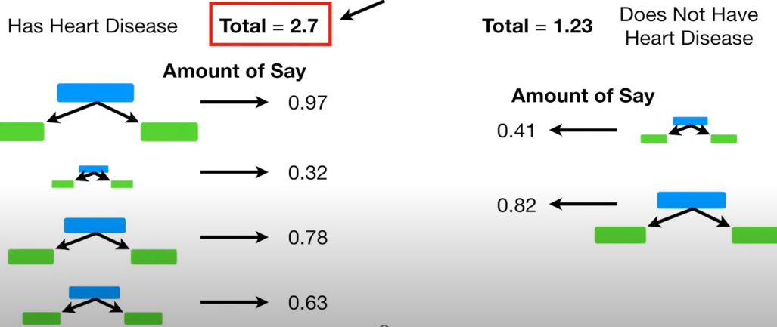
Patient as Heart disease since this as large sum
So this is how Ada boost convert weak learners to strong learners.

